Slide 1
The Substitution Rule by: Dr.Hiba Omer lec2

Slide 2
The Substitution Rule
If u=g(x) is differentiable function whose range is an interval I, and f is continuous on I, then
The Substitution rule is proved using the Chain Rule for differentiation.
The idea behind the substitution rule is to replace a relatively complicated integral by a simpler integral. This is accomplished by changing from the original variable x to a new variable u that is a function of x.
The main challenge is to think of an appropriate substitution.

Slide 3
Example
The variable of integration must match the variable in the expression.
Don’t forget to substitute the value for u back into the problem!

Slide 4
Substitution rule examples
Example
We computed du by straightforward differentiation of the expression for u.
The substitution u = 2x was suggested by the function to be integrated. The main problem in integrating by substitution is to find the right substitution which simplifies the integral so that it can be computed by the table of basic integrals.

Slide 5
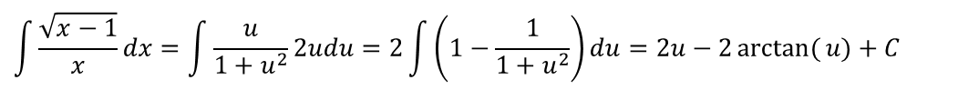
Example about choosing the substitution
Example
Solution
This rewriting allows us to finish the computation using basic formulae.
$$\int{\frac{\sqrt{x−1}}{x}}dx=\int{\frac{u}{1+u^{2}}2udu=2\int{\left(1−\frac{1}{1+u^{2}}\right)}}du=2u−2\arctan{(}u)+C$$
Next substitute back to the original variable.

Slide 6
The substitution rule for definite integrals
If g’ is continuous on [a,b], and f is continuous on the range of u=g(x) then

Slide 7
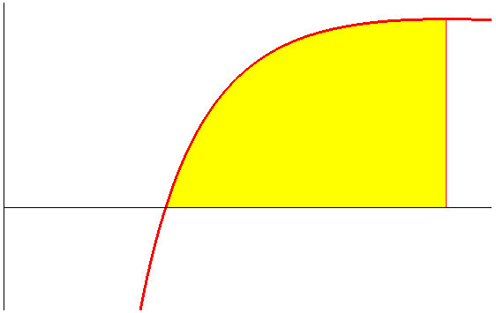
The substitution rule for definite integrals
Example
1
e
The area of the yellow domain is ½.

Slide 8
Example
new limit
new limit
Find new limits

Slide 9
Example
Don’t forget to use the new limits.

